Slide 1
Life-Style Builder
Shahar Almog – 206217606
Yehontan Ben Shitrit - 315687442

Slide 2
TABLE OF CONTENTS
1
2
Introduction
Our work
3
4
GUI
Tests
Intro, Background and related works
Dig into the solution
How the product should look
Testing the limits of the product

Slide 3
INTRODUCTION

Slide 4
What is lifestyle?
Lifestyle refers to the way a person lives, including their attitudes, values, behaviors, and habits.
A person's lifestyle is influenced by their personal preferences, cultural background, socioeconomic status, and other environmental factors.

Slide 5
LifeStyle Affects
METHODS
Activities
Exercise
Diet
Work
Notes:
Social Activities
Exercise
Diet
Work Habits

Slide 6
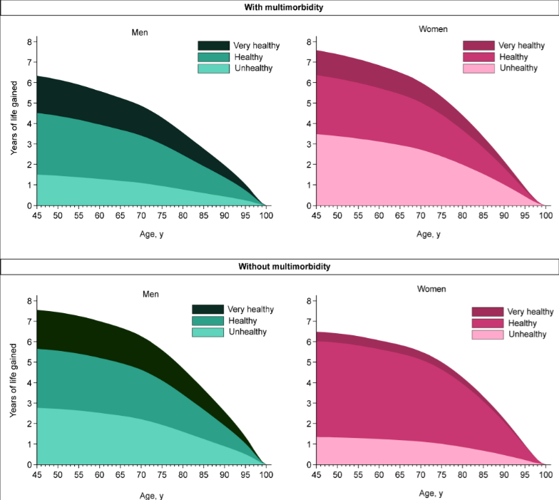

Slide 7
Our Work

Slide 8
Goals
We are going to develop a user-friendly and cross-platform application allowing:
1.Building and sharing healthily lifestyle programs.
2.Tracking of the programs implementation and feelings.
3.Interaction between specialists and users.

Slide 9
Features
1.The app will contain medical information about the patients.
2.The app will be able to automatically adjust the lifestyle programs to the health conditions of the patients.
3. The app will alarm the specialist and the patient when user’s health changes required special attention.

Slide 10
Functionality
Every user can login as patient or specialist.
Specialist can create or use from the library and make copy different actions of the healthy life or doctor prescriptions.
Each action has ability to obtain a free text comment from the patient.

Slide 11
Functionality
Specialist create from the library and make copy "Programs" for a selected time period, which are built from the actions.
The "Program" is an ordered sequence of the actions.
Each action has a feedback.

Slide 12
Functionality
Each patient can search programs(with filters).
The patient medical card should be similar with clinic (with possibility to reuse the data).
When the program is running, it publishes goals for every day.
To run a several program in parallel required approval of all specialist.

Slide 13
Functionality
When several programs are running simultaneously the goals should be with different labels (and differ from the not-Program goals.
The patient can see his running program list (and change the status or access to his data) and previous programs.
Patient can look on the future and past goals via the calendar.

Slide 14
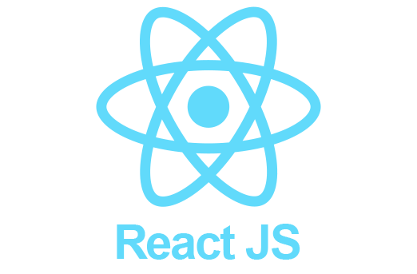
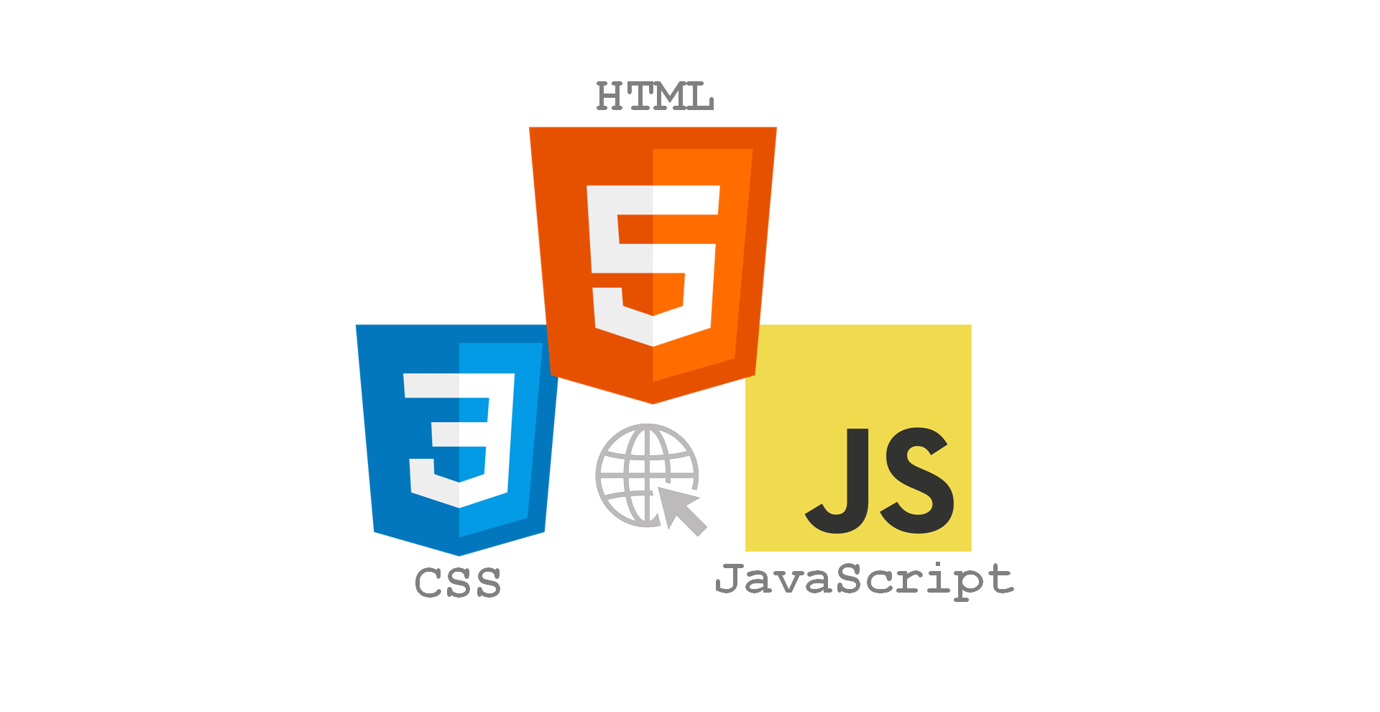

Implementation

Slide 15
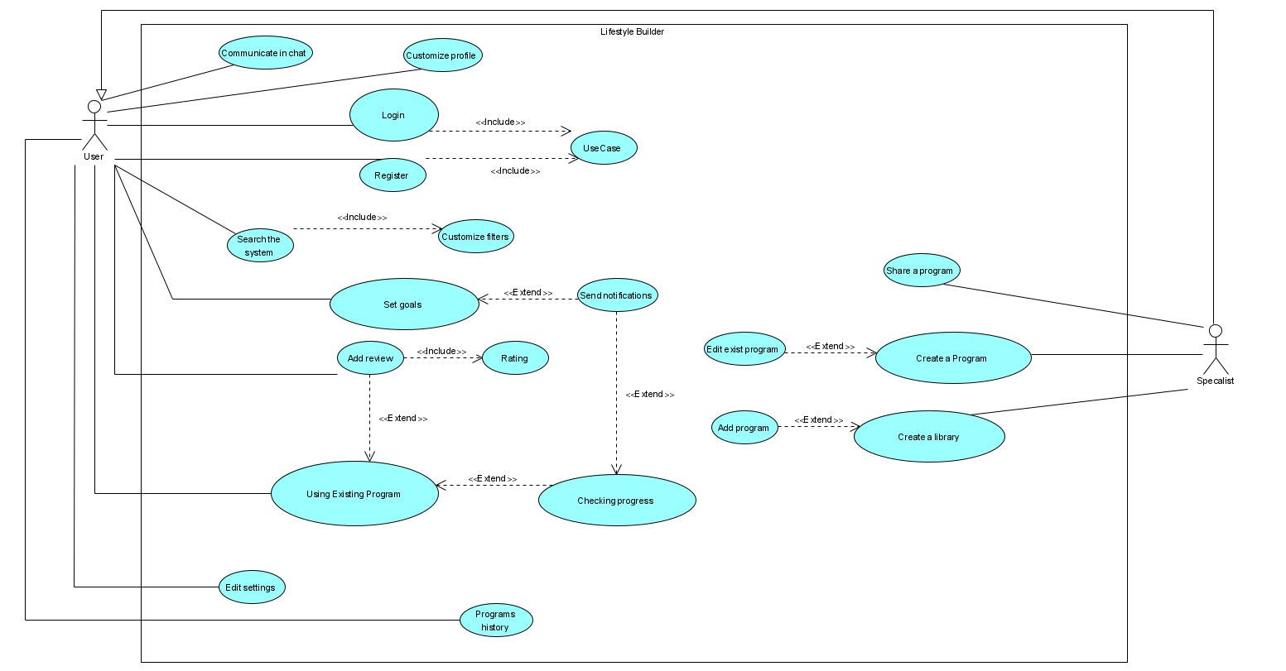
Use Case

Slide 16
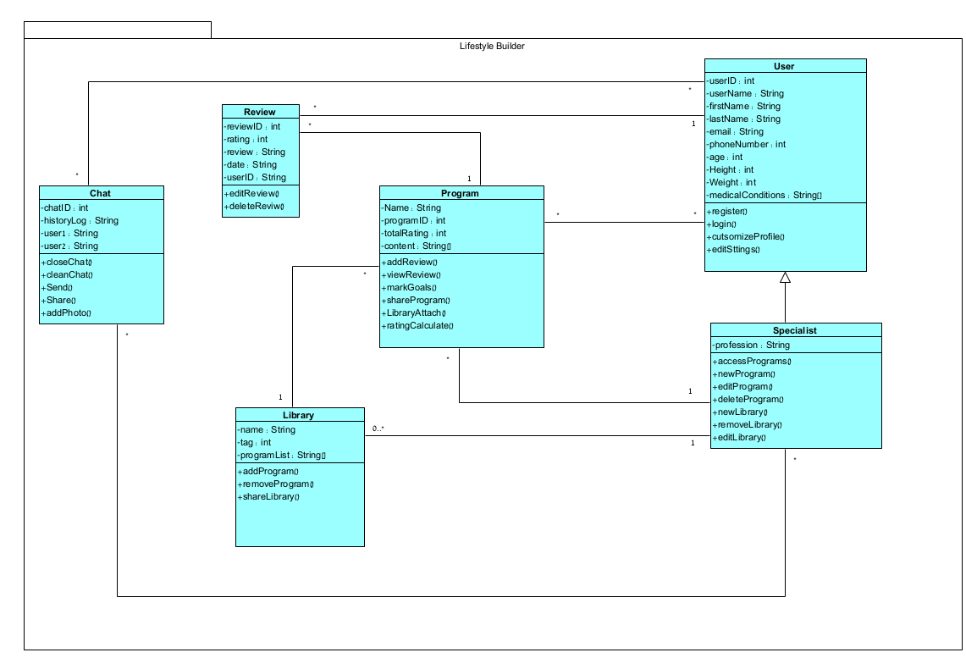
Class

Slide 17
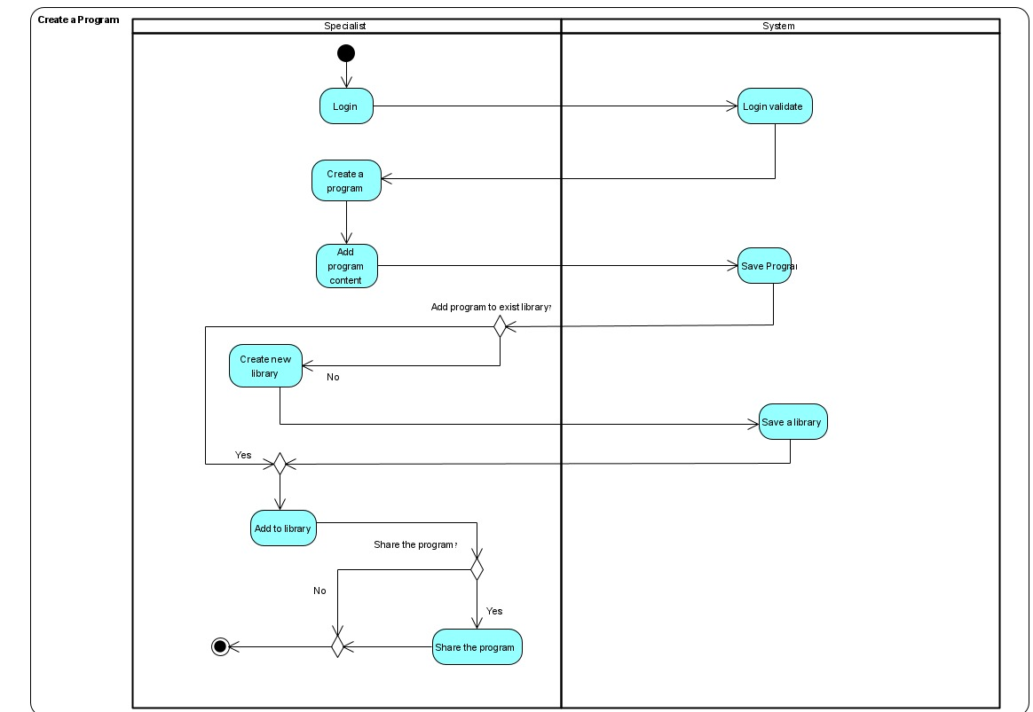
Activity Diagram #1

Slide 18
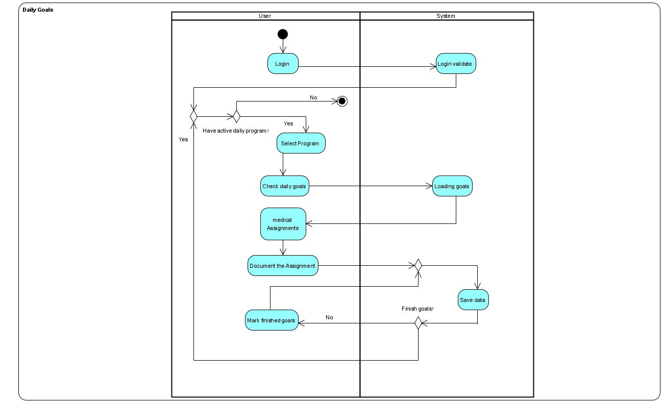
Activity Diagram #2

Slide 19
GUI

Slide 20
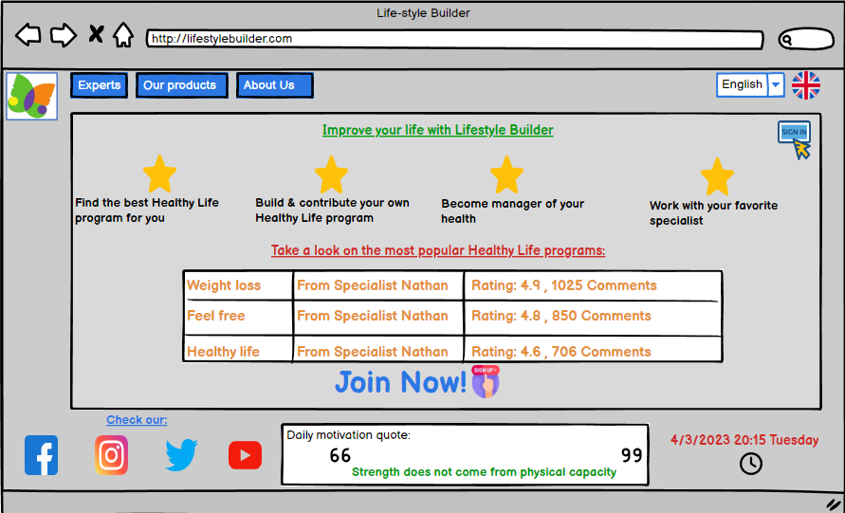
Home Page

Slide 21
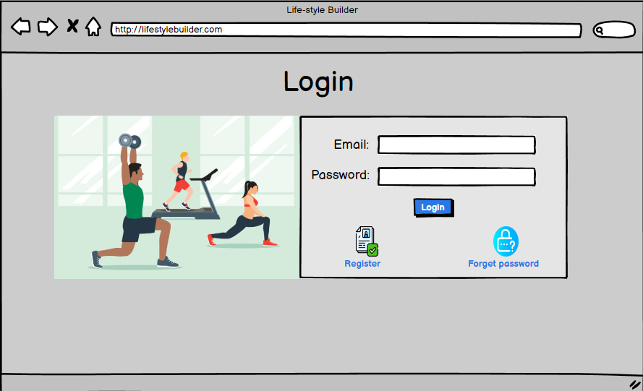
Login Page

Slide 22
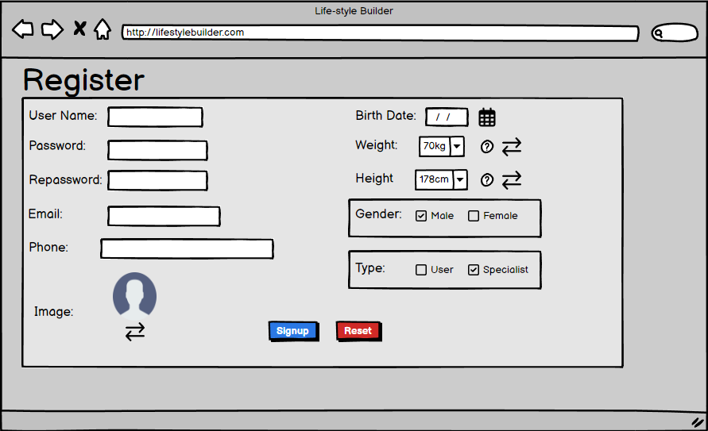
Register

Slide 23
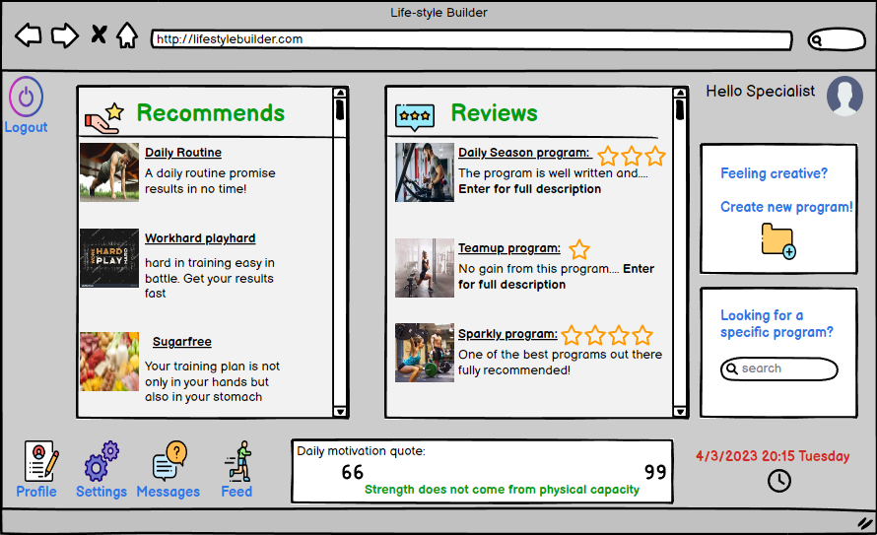
Home Page - Specialist

Slide 24
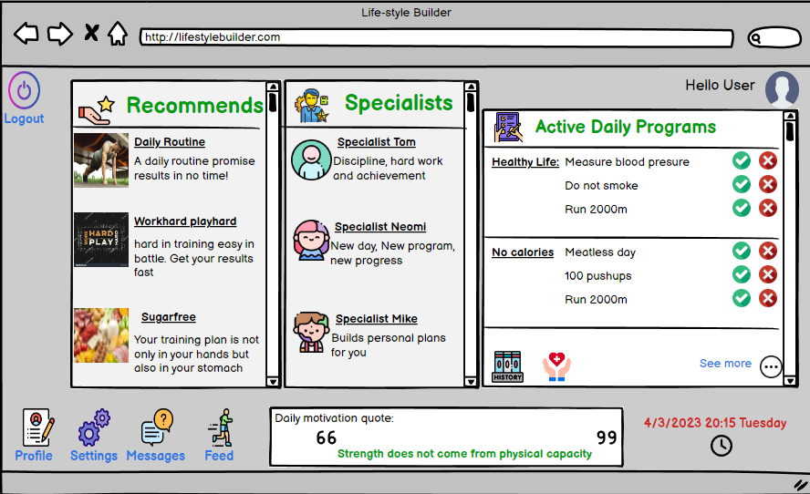
Home Page - User

Slide 25
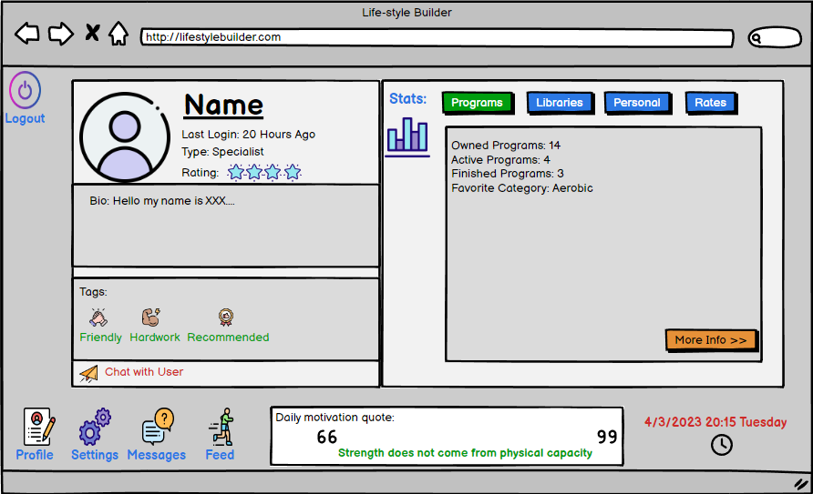
Profile

Slide 26
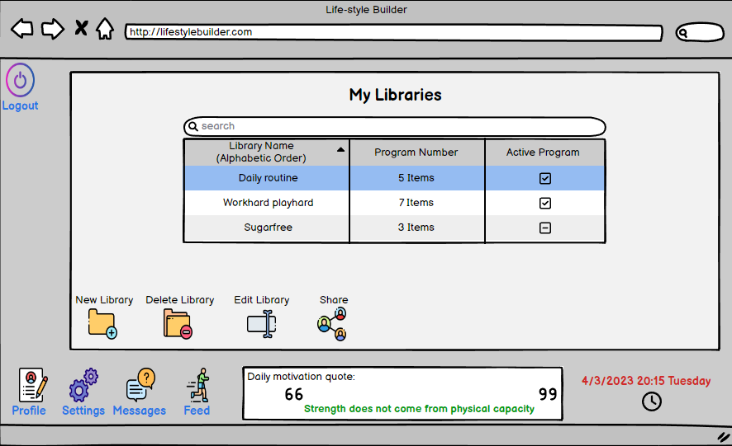
My Libraries

Slide 27
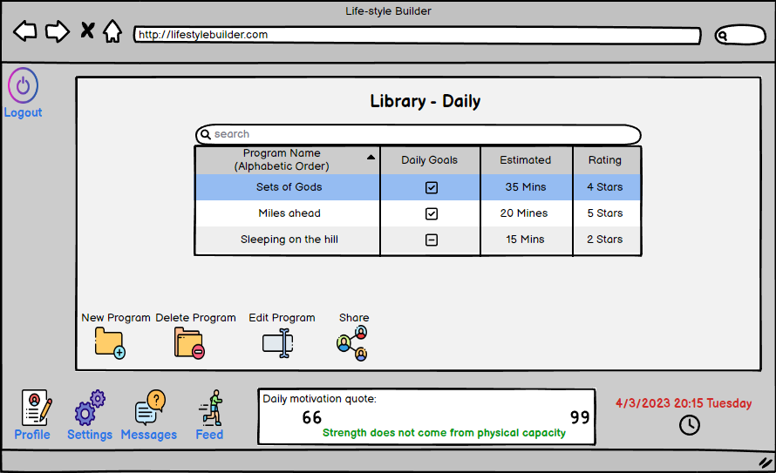
My Programs

Slide 28
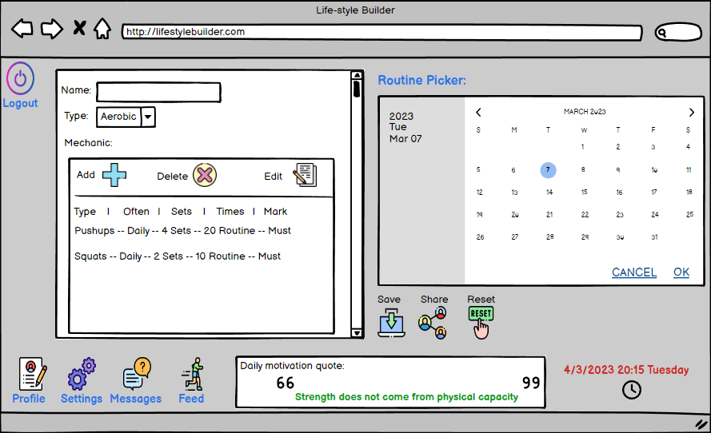
Create Program

Slide 29
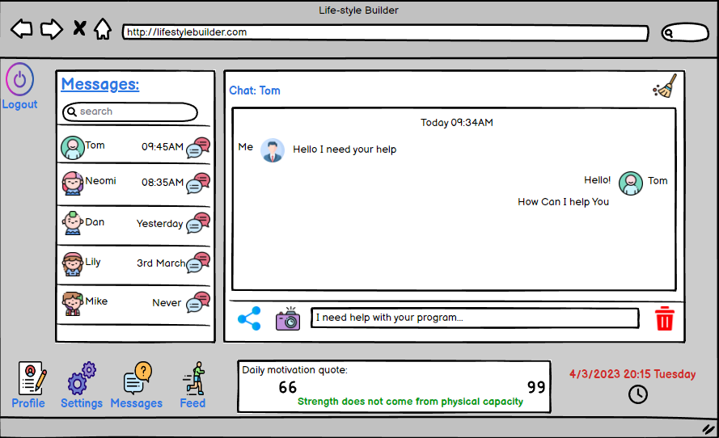
Chats

Slide 30
Tests

Slide 31
Unit Testing
Registration Testing
No. | The Test | Expecting Result
1 | Enter the empty required field | Error alert: "Please fill in all the required fields"
2 | Wrong password pattern | Error alert: "Please retype a password that matches the password pattern"
3 | Password verification does not match | Error alert: "The passwords do not matches please retry again"
4 | Wrong email pattern | Error alert: "Please retype the email that matches the email pattern"
5 | Used email | Error alert: "The email you entered is already in use"

Slide 32
Functional Testing
Chat Testing
No. | The Test | Expecting Result
1. | Sending message | The message sent from one user to another user needed to be presented on both chat screen
2 | Open new chat | The correct users that chatting is shown
3 | Close chat | The chat is closed, and the screen switched to the last page
4 | Chat History | Chat history is saved even if the chat close and reopen
5 | Delete history | Removing all the chat history between the users

Slide 33
THANKS FOR LISTETING!
Shahar And Yehonatan

